Slide 1
Breastfeeding Flow Meter
Team May1726

Slide 2
Team Members
Webmaster: Michael Brumfield
Key Concepts: Boris Ndoutoume
Key Concepts: Daryck Brown
Communications: Richard Millan
Team Leader:
Chukwudike C-Madu

Slide 3
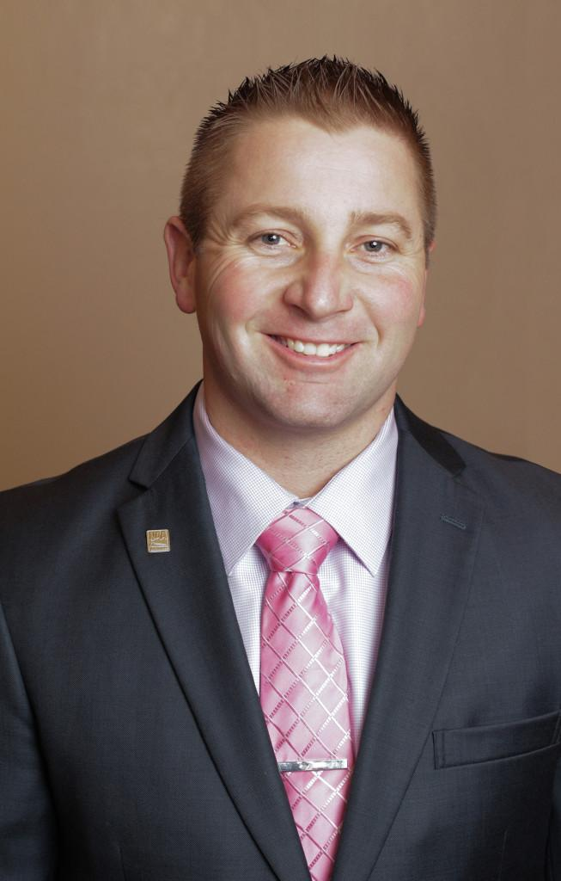
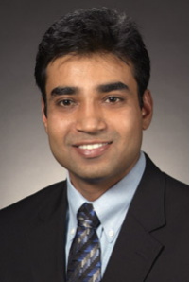
Stakeholders
Client :
David Whitaker Entrepreneur & Investor
Advisor :
Dr Pandey Santosh PHD Electrical engineering

Slide 4
Problem Statement
This device is not a medical device but rather a device to complement the breastfeeding experience of a mother. Mothers currently do not know the exact quantity of milk their babies drink when breastfeeding. The Titbit is a breast milk flow meter that will help mothers track the volume of milk they feed their babies in real time. Along with the breast flow meter, we are also building a mobile App in which the data will be sent to real time and display the statistic and volume of milk to the mother.
1

Slide 5
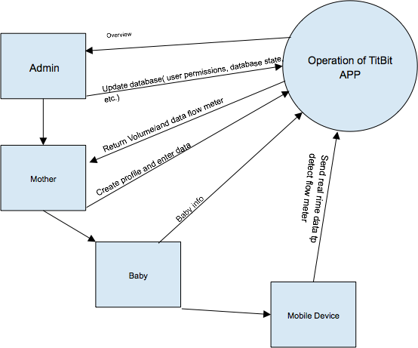
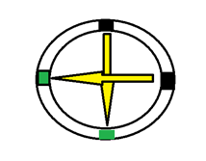
Conceptual Sketch
Software
Hardware
LEDs
Sensors
Bluetooth
2

Slide 6
Functional Requirements
-Hardware:
The device shall detect & measure flow of milk real time
The device shall be battery powered
The device shall communicate with bluetooth with a mobile application
-Software:
The Mobile Application shall receive data over bluetooth
The user shall be able to view real time volume in milliliters
3

Slide 7
Technical/Other Constraints/Considerations
FaceBook integration will not properly work until the app is on the Google Play Store
The app only works with android devices
Safety Risks for baby
5
Notes:
Mike

Slide 8
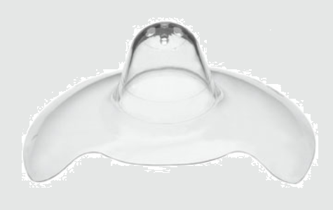
Market survey – articulate what makes your project unique
Our project is unique because it provides real-time data of how much breast milk a mother has fed her child.
Very mother friendly and comfortable design . Medela nipple is popular worldwide.
Has minimal steps and is easy to use. The mother will not feel too much of a burden when using the device.
Enhance and prolong the breastfeeding experience.
6

Slide 9
Potential Risks & Mitigation
Our biggest fear right now will be making sure the product and parts are 100% safe for the baby and free of any potential choking hazard.
Huge differences in the size of the potential mother’s breast and nipples. A lot of women may have different shapes of nipples that do not fit the typical Medela nipple shield sizes.
7

Slide 10
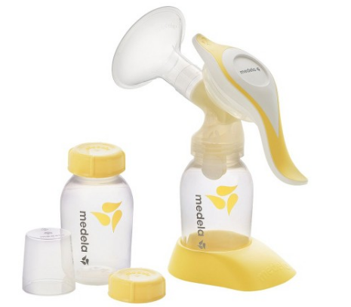
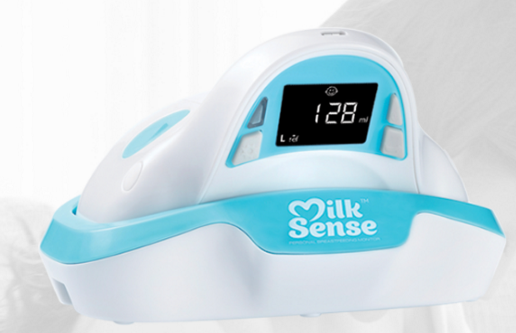
Existing Technologies
Breast pumps and milk logging apps- Long lengthy process and puts stress on mother.
Milksense- measures changes in the milk alveoli in order to determine the amount of milk the baby receives from the breast, by tracing changes in tetra-wire capacitance and resistance of the tissue before and after breastfeeding.
9

Slide 11
Comparison to Existing Products
One device, less confusion / ease of use!
Mobile, Concealable, Washable
Real-time measuring: measures the actual amount of milk the baby consumes.
No need for calibration: immediate accurate use
Enhance and prolong the breastfeeding experience
Not dependent on mother's size, depth of tissue, BMI, etc.
10

Slide 12
Project Milestones & Schedule
Semester 1:
Determine optimum method of measuring flow:
Optical Sensors.
Develop initial design of the flowmeter and mobile app template.
Write the program of mobile app.
Research, find, and order hardware components.
Vishay LEDs & ambient light sensors
Begin testing of the ambient light sensor.
Winter Break:
Designed a flex PCB.
Semester 2:
Construct Prototype of flowmeter.
Test flowmeter prototype.
Calculate regression equation relating measured light intensity to rate of flow.
Design and implement bluetooth transmitting communication.
Test communication between the flowmeter and mobile app.
11

Slide 13
SYSTEM DESIGN

Slide 14
Functional Decomposition
Unsigned Flow Rate sent via Bluetooth
Light intensity: 16 bits value reads by Light sensor
Float Flow Rate : -2.111*log(Light intensity)+11.537
Unsigned Flow Rate : Flow Rate was casted and copy into a byte array of size 1 and sent via Bluetooth
The bluetooth on the app receives Unsigned Flow Rate in a byte array as the flow of milk.
Based on the the formula
V= Flow*Time , we evaluate the volume of milk consumed so far.
12

Slide 15
Detailed Design
Flowmeter:
Optical Sensing Ring:
A LED and light sensor pair along the perimeter of the ring.
Ambient light sensor: Vishay Semiconductors’ VEML 6030.
Flexible PCB:
This board control the functionalities of the flowmeter.
Bluetooth Transmitter:
a bluetooth module will enable communication between the flowmeter and the mobile app.
Lithium Battery:
Will supply voltage to the flowmeter
13

Slide 16
HW/SW/Technology Platform used
Hardware
Vishay Light Sensor VEML 6030
Arduino
Software
Android Studio
FaceBook API
Bluetooth API
14
Notes:
Mike

Slide 17
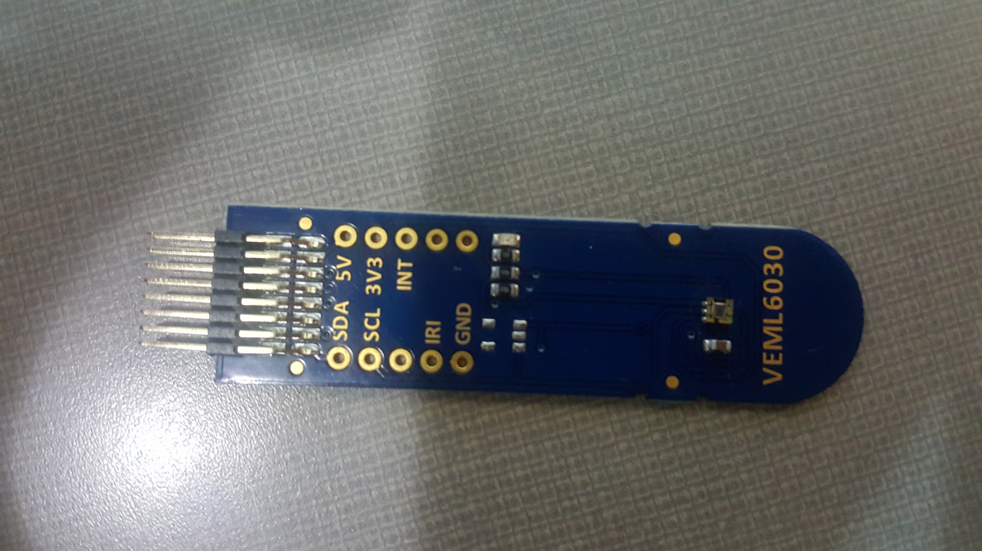
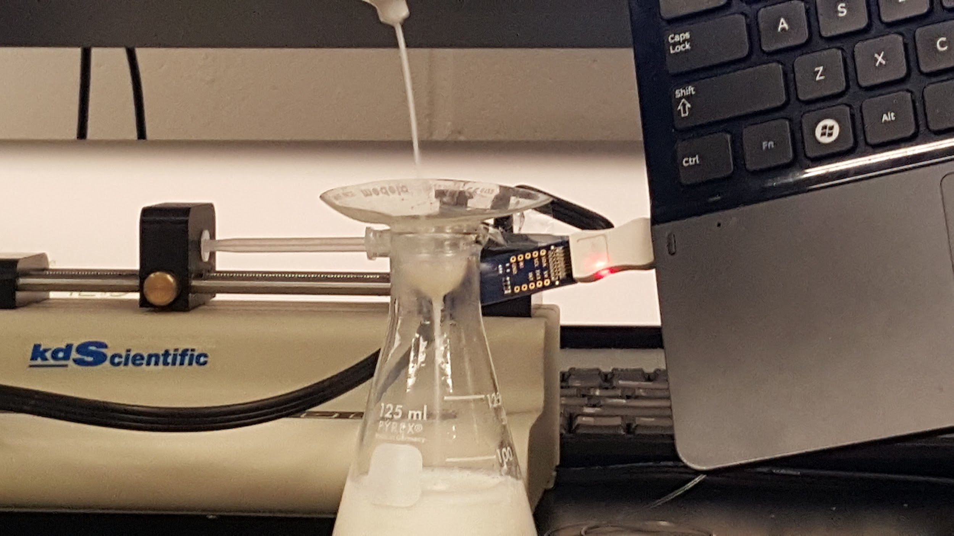
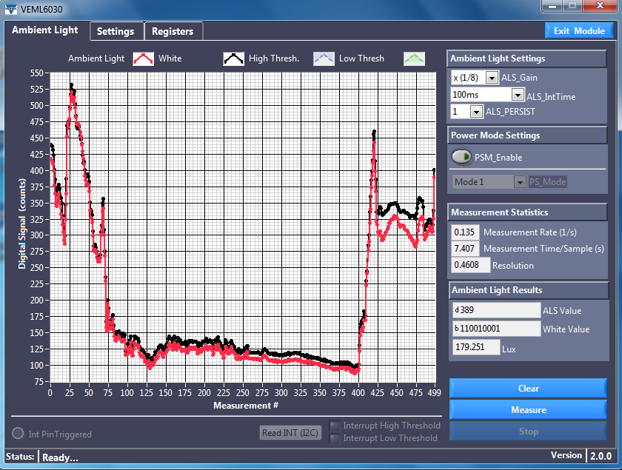
Test Plan – simulation, what tests
VEML6030 Demo Board
Equipped with ambient light sensor software
16-bits correspond to light values (ALS)
Convert to Lux
Use binary values to detect flow in software.
15

Slide 18
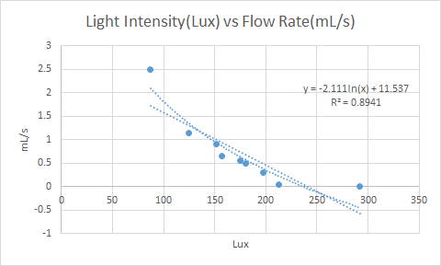
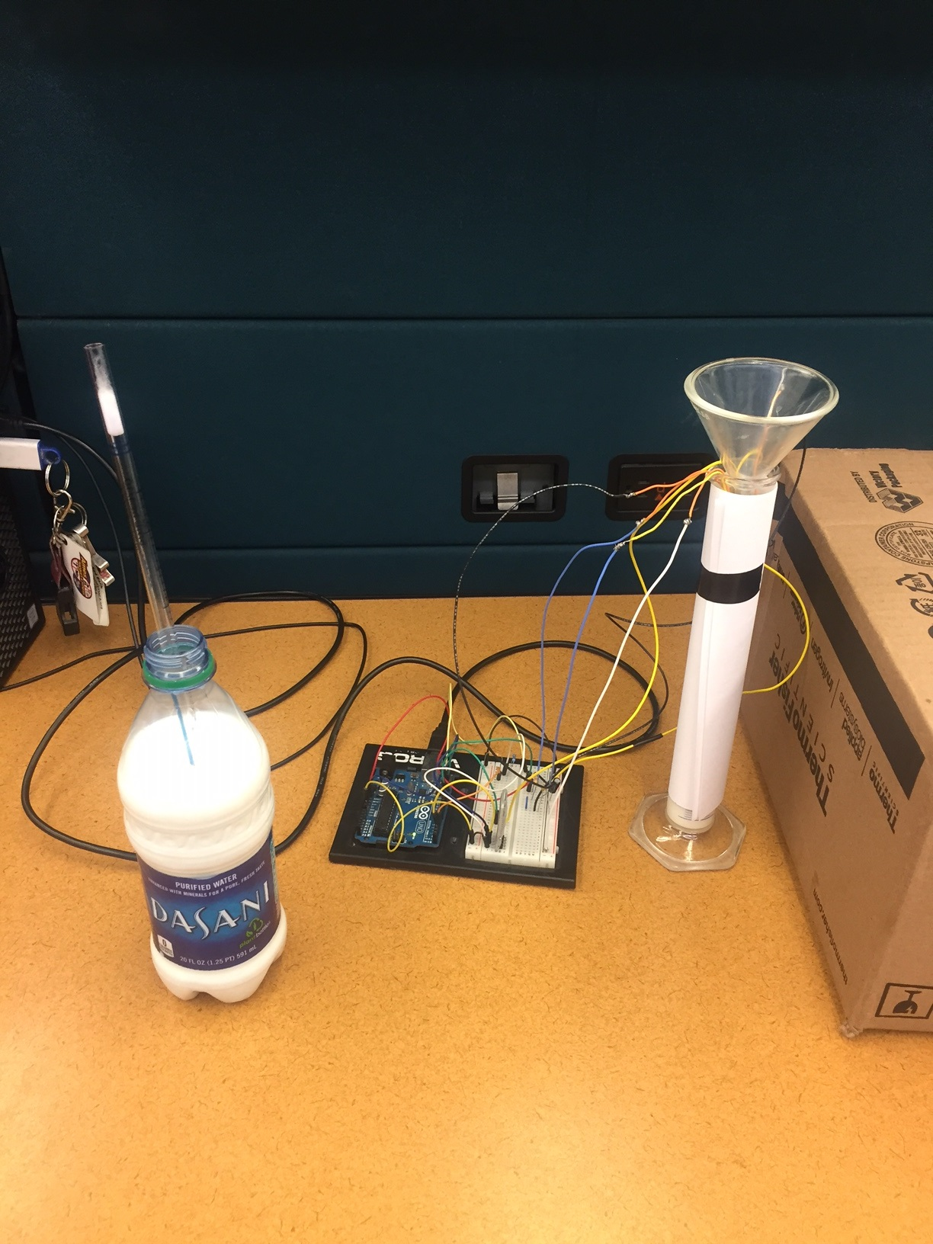
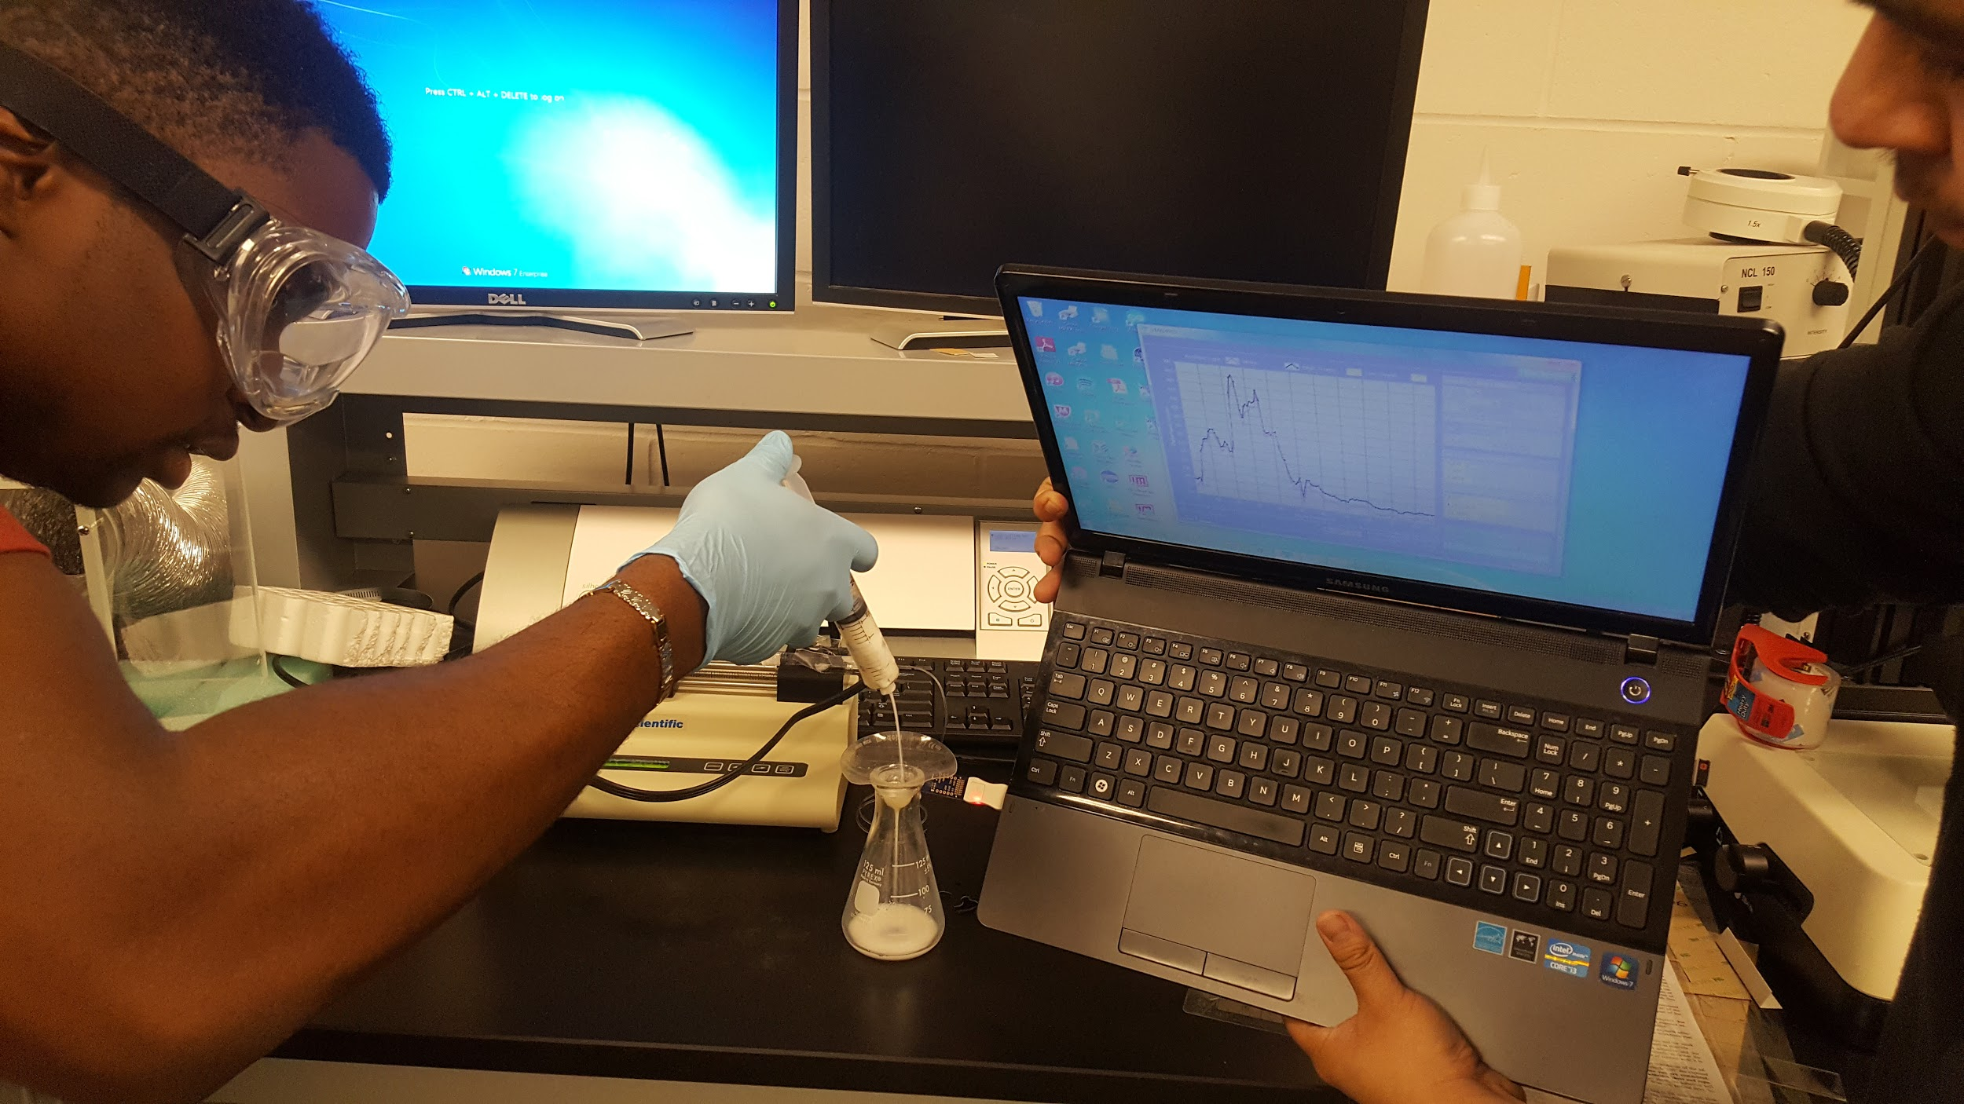
Testing (continued)
Hardware Testing:
Recorded Lux values at specific Flow rates using the hardware setup and a testing program.
Used a logarithmic fit:
Y = Flow Rate=-2.111*log(ALS)+11.537

Slide 19
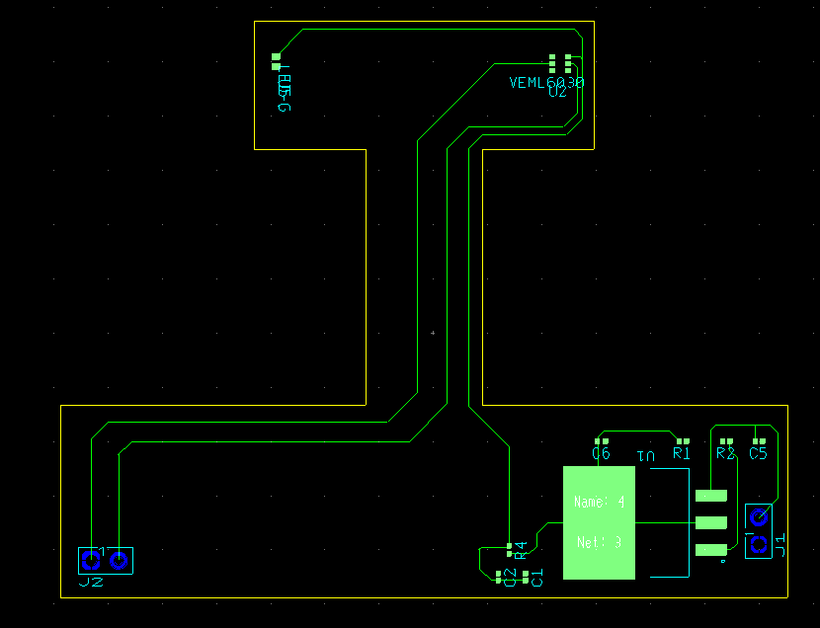
Prototype Implementations or Basic building block
The prototype consists of a flexible “I” shaped PCB
The “I” shaped board cups around the mother’s breast
Top half: VEML6030 sensor and green LED
Bottom half: power/setup components and header connectors
16

Slide 20
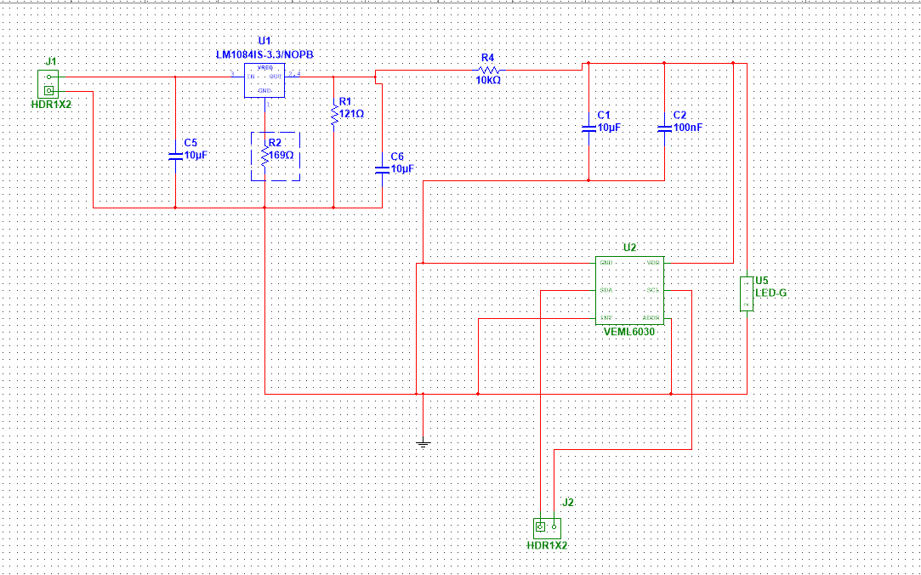
Prototype Schematic
LM1084 voltage regulator:
Vout = 1.25(1+R2/R1) = 3V
R4 = 10K ohms, C1 = 10uF, C2= 100nF
Components used for the setup of the VEML6030 sensor
VLMS1500 LED is placed across the sensor

Slide 21
CONCLUSION

Slide 22
Demo : Proof of concept

